Slide 1
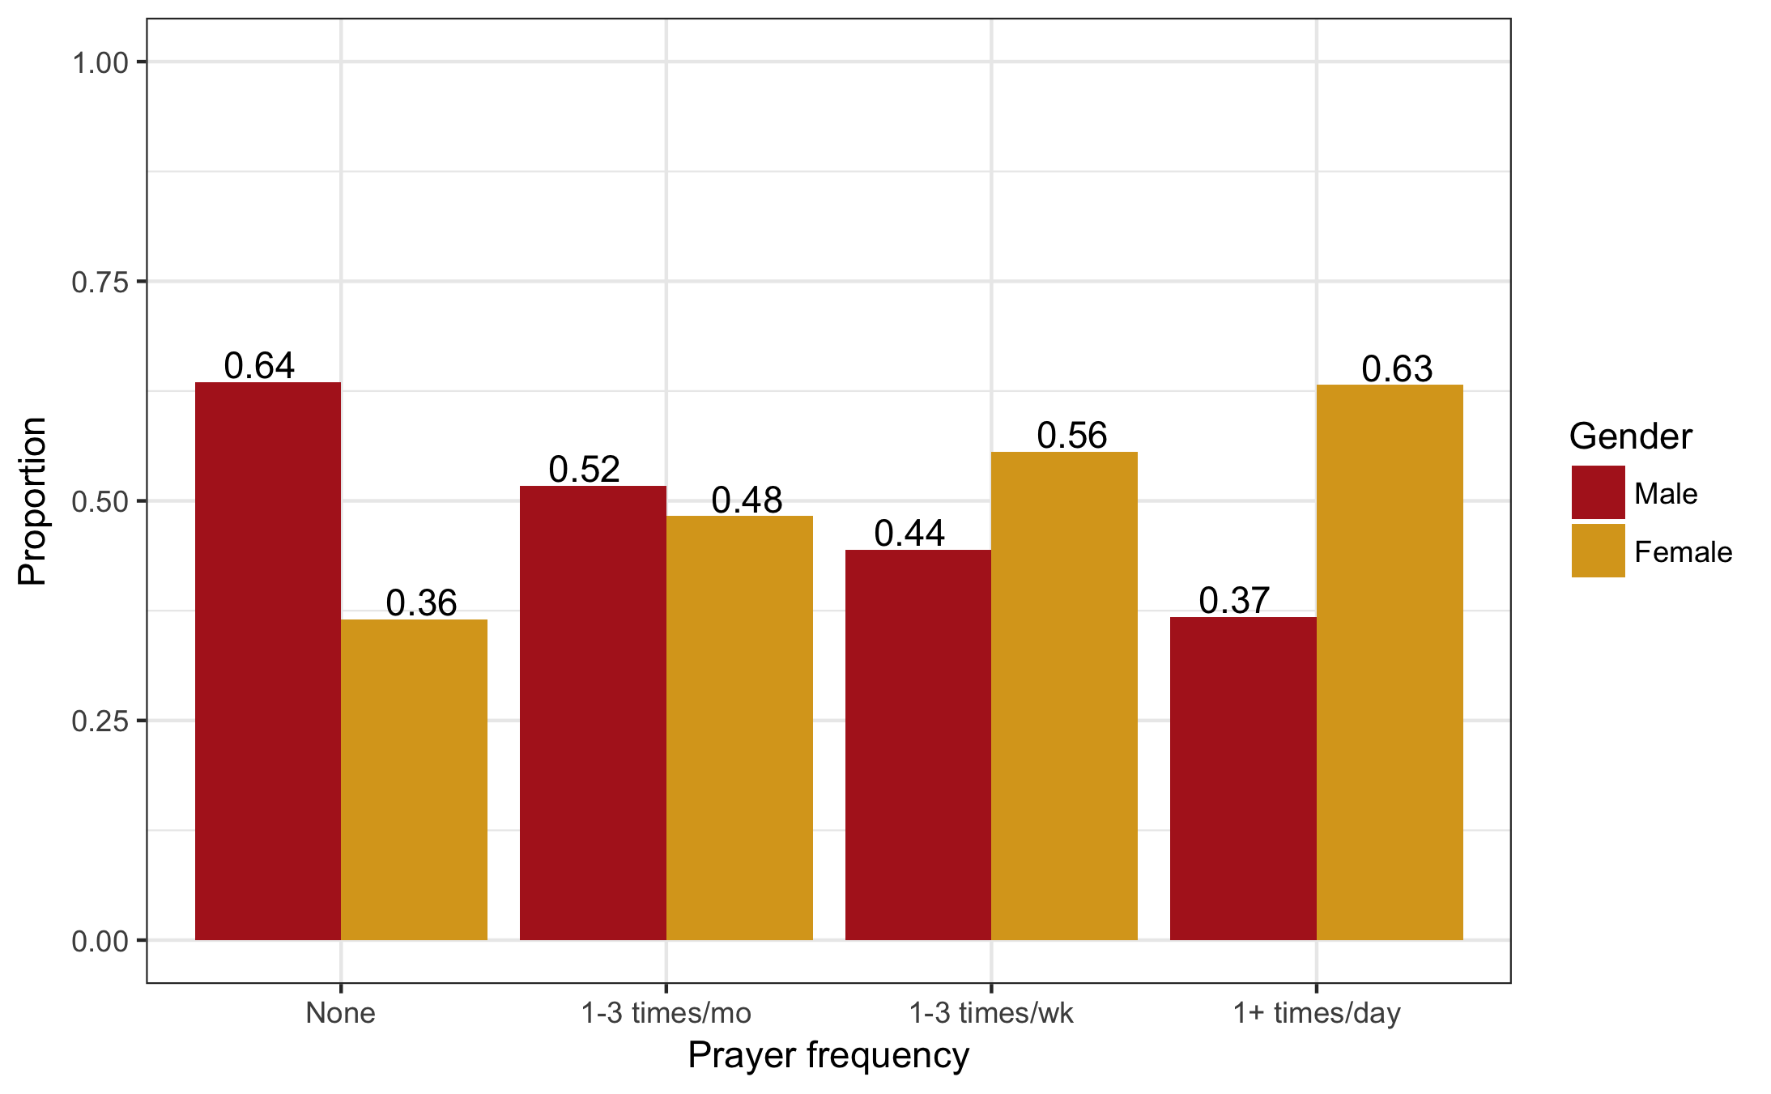
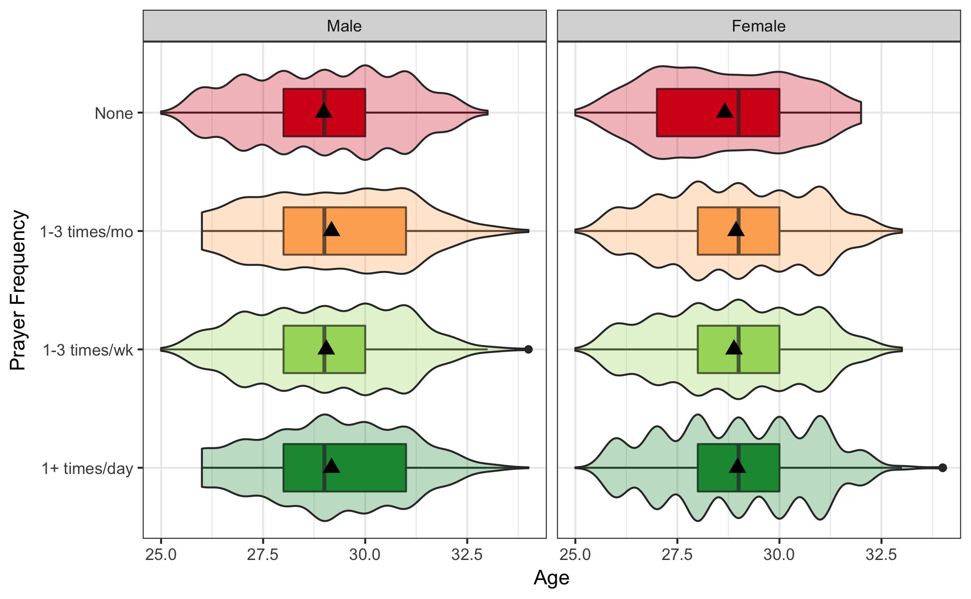
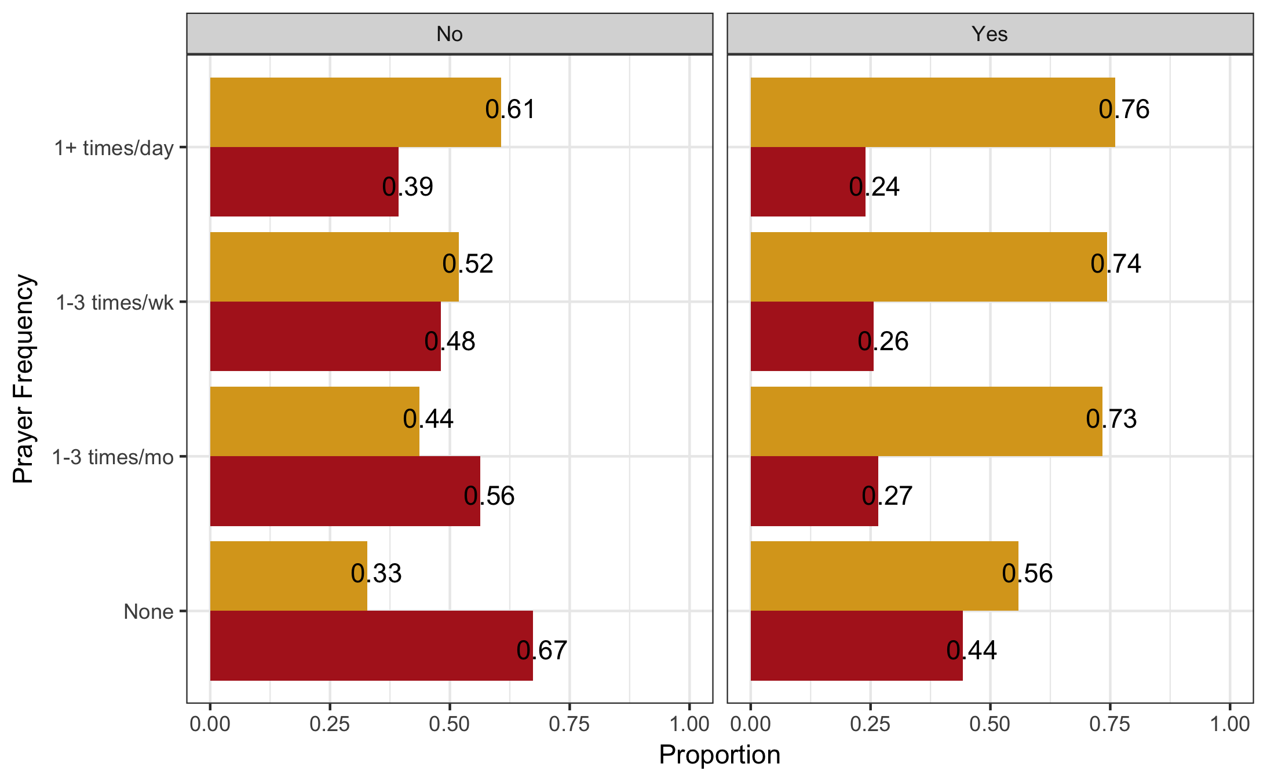
The relationship between mental health, education, and religious engagement
Balfour, Nick
CSU, Chico Math 615
INTRODUCTION
METHODS
RESULTS
DISCUSSION
For this project I will be exploring the relationships between religious engagement, education and mental health. More specifically I’m going to examine the interrelationships between religion and education on depression and suicide using data gathered from the National Longitudinal Study of Adolescent to Adult Health. Previous studies covering religion and mental health have highlighted religion as a significant source of social support in the form of community. While previous studies have examined the value of religious engagement in regards to mental health, I will specifically be relating it to suicide and depression in order to determine if it could possibly reduce their occurrence.
Sample characteristics : National Longitudinal Study of Adolescent to Adult Health
6,504 participants
Age: 24-32
Gender: Male and Female
Ethnicity: Range
Survey conducted via in-home interview
Gender- Does the person identify as male or female?
Age- What is the person’s age?
Depression Diagnosis – Has a doctor or nurse ever given the person a diagnosis of depression?
Prayer Frequency- How frequently does the person pray?
-Participants self identified prayer frequency from list of rates
Religious engagement- How often does the person engage in religious activities within the community?
-Participants self identified frequency of engagement from list of rates
Chi-squared test of association
-To test the difference in Prayer frequency within Gender
Two way ANOVA Model –
-I tested for an association between Prayer Frequency and Age tested and determine Gender acted as a moderator
# Chi-Squared Test of Equal Proportions –
-To test for an association between Prayer Frequency and Gender and determine the effect of Depression diagnosis as a potential moderator.
My results show that both religious status, prayer frequency and gender have a significant association with depression diagnosis. Gender was found to be a significant moderator of the association between religious and depression status with non religious females more likely to be depressed than non religious males. These results provide support for the hypothesis that religious engagement can impact mental health status in terms of depression.
Females also were found to be more likely to have a depression diagnosis than males.
Females were found to pray more frequently than males
VARIABLES
RESEARCH PROBLEMS
Initial observations of results indicate a possible relationship between gender and depression status that could be a greater factor than education on mental health. Additionally, religious status could also be a predictor of mental health status. This relationship can be further investigated by incorporating finer metrics of religious engagement like attendance at religious community events or the specific role that religion plays in a person's life.(Will test for this) Future research in this area should include more extensive demographics and investigate other religious denominations. For instance, the people who self identified as religious in this sample were mostly within Christian denominations and may not represent the effects of engagement in other religions.
Umberson, D., & Montez, J. K. (2010). Social Relationships and Health: A Flashpoint for Health Policy. Journal of Health and Social Behavior, 51(1_suppl). doi:10.1177/0022146510383501
Flannelly, K. J., Koenig, H. G., Ellison, C. G., Galek, K., & Krause, N. (2006). Belief in Life After Death and Mental Health. The Journal of Nervous and Mental Disease, 194(7), 524-529. doi:10.1097/01.nmd.0000224876.63035.23
Berkman, N. D., Sheridan, S. L., Donahue, K. E., Halpern, D. J., & Crotty, K. (2011). Low Health Literacy and Health Outcomes: An Updated Systematic Review. Annals of Internal Medicine, 155(2), 97. doi:10.7326/0003-4819-155-2-201107190-00005
Brown, S., & Taylor, K. (2007). Religion and education: Evidence from the National Child Development Study. Journal of Economic Behavior & Organization, 63(3), 439-460. doi:10.1016/j.jebo.2005.08.003
A person’s educational experiences lays the foundation for their future career. However it is unknown how well it prepares them to handle mental health problems they might encounter and what risk factors may be involved.
While both religious institutions and educational institutions provide support in the form of knowledge and can have significant impact on a person’s future, it is unclear what impact it has on their mental health status.
RESEARCH QUESTIONS
1. Does the level of a person’s religious engagement relate to their mental health?
2. Does a person’s mental health status relate to their level of education?
3. Is education or religious engagement a better determinant of mental health status?
IMPLICATIONS AND FUTURE RESEARCH
STATISTICAL ANALYSIS
REFERENCES
nbalfour@mail.csuchico.edu

